Slide 1
TEAM NAME PANDAVAS
HackOfiest 2.0
Members
1.) Abhishek Potekar - 2nd Year B.Tech ECE, LPU
2.) Piyush Kachhwal - 2nd Year B.Tech ECE, LPU
3.) Gayatri Verma - 2nd Year B.Tech ECE, LPU

Slide 2
Water management system

Slide 3
Problem Statement
1.)Overflow of water from the Overhead tanks and Water reservoirs in the cities.
2.)Quality of the water is degrading in the cities and the report regarding it with the daily analysis has to be maintained.

Slide 4
introduction
Water is the precious part of our life, thus it is our responsibility to save it and manage it as per our needs without wasting it.
From this prototype we will be able to control and analyse the water usage of the societies situated in the cities like Mumbai, Delhi etc.
With this prototype we are trying to solve the problem of water wastage due to the overflow of water in the buildings and also finding the quality of the water using Sensors .

Slide 5
BRIEF
Water Management System is totally based on IOT System and it is a self automated system that prevents the overflow of the water ,when the tank or any large storage reservoir is filled completely.
This device also alerts the user when the water storage is full and thus it gets automatically turned off the water pump with the relay module.
This actually helps to save wastage of precious resources like water and electricity, and give the recent updates on water usage in the societies.

Slide 6
INNOVATION
This system is totally based on the real time data analysis, which includes the IOT i.e. Internet of things concept for the real time water management.
Such systems require electronics components to be implemented and store the data at a cloud server.
Also it needs both Hardware and Software development to work with a sync and make it a real time system.
We are working on AI Voice assistance to support the more dynamically and data synchronisation.

Slide 7
Hardware components
1.) WATER FLOW SENSOR | It monitor the amount of water being supplied and used , the rate of flow of water has to be measured.
2.) TURBIDITY SENSOR : | It is used to measure the clarity and transparency of the water
3.) LIQUID pH SENSOR: | Liquid pH Sensor is used to keep the check on the pH level of the water
4.) TDS SENSOR : | used to measure the total dissolved solids in the water, thus it will keep check on the dissolved salts and other particles in the scale of ppm.
5.) RELAY MODULE: | An electromagnet switch, which helpful for automatically switching off the water pump.
6.) MICRO CONTROLLER: | CPU of this system, It controls and commands all the Peripheral devices connected to it.
7.) NODE MCU MODULE: | A WIFI module, that is the part of IoT system, which helps for data communication and synchronisation.

Slide 8
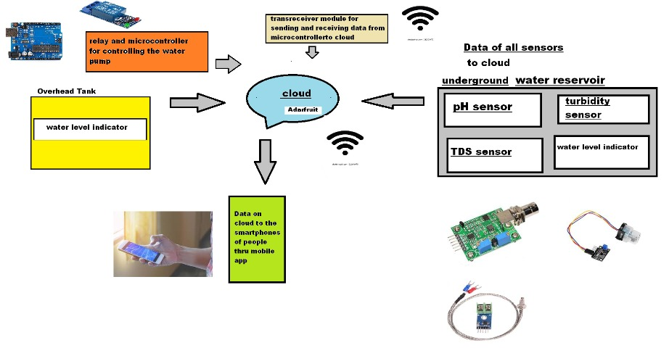
BLOCK DIAGRAM
Level of water in the Tank
Real time Data on the Cloud Server
Communication Interface
Switching of the Motor
ON/OFF.

Slide 9
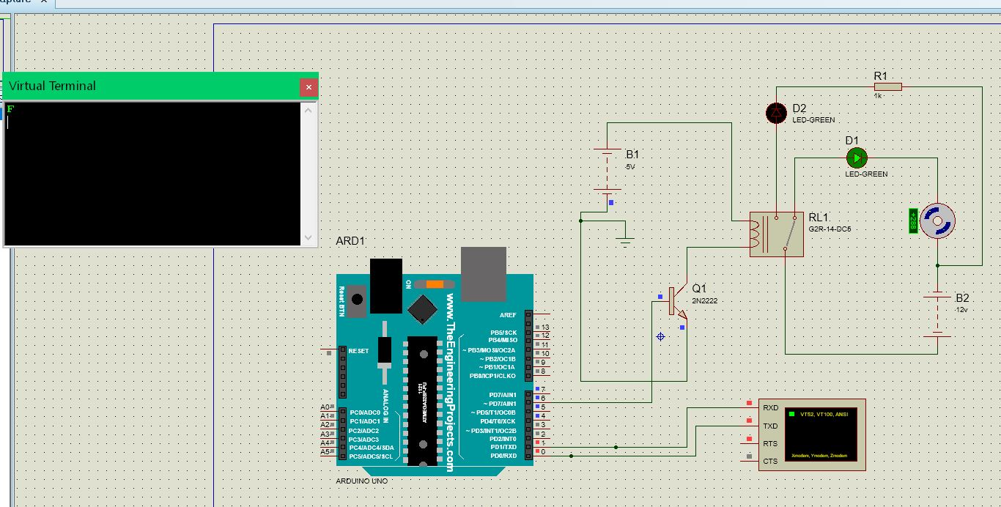
PROTEUS SIMULATION OF HARDWARE

Slide 10
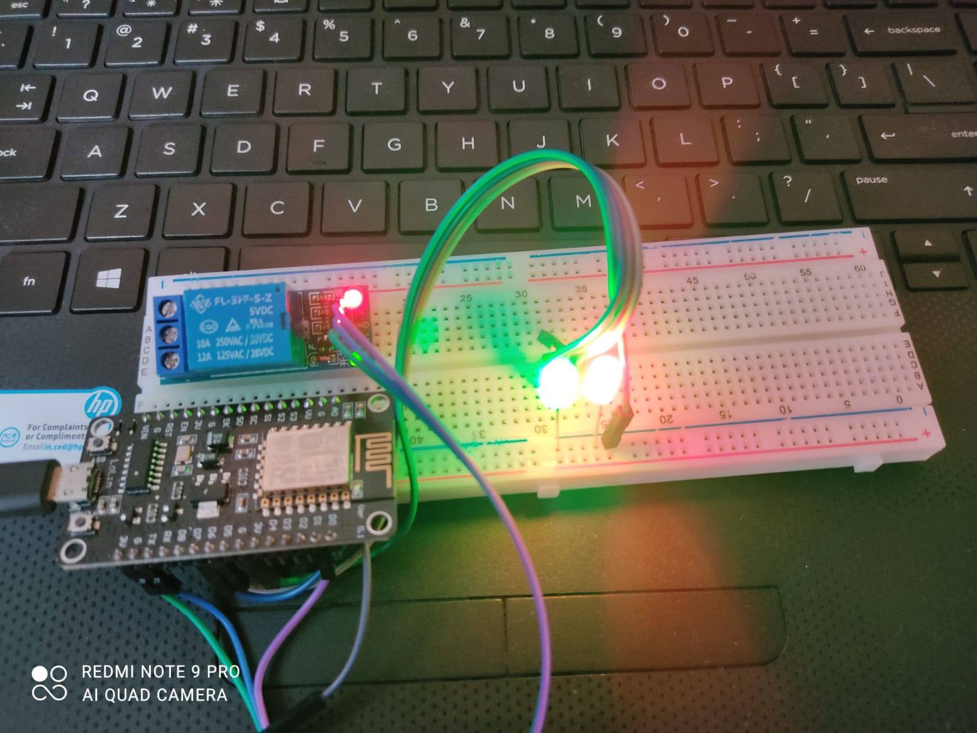
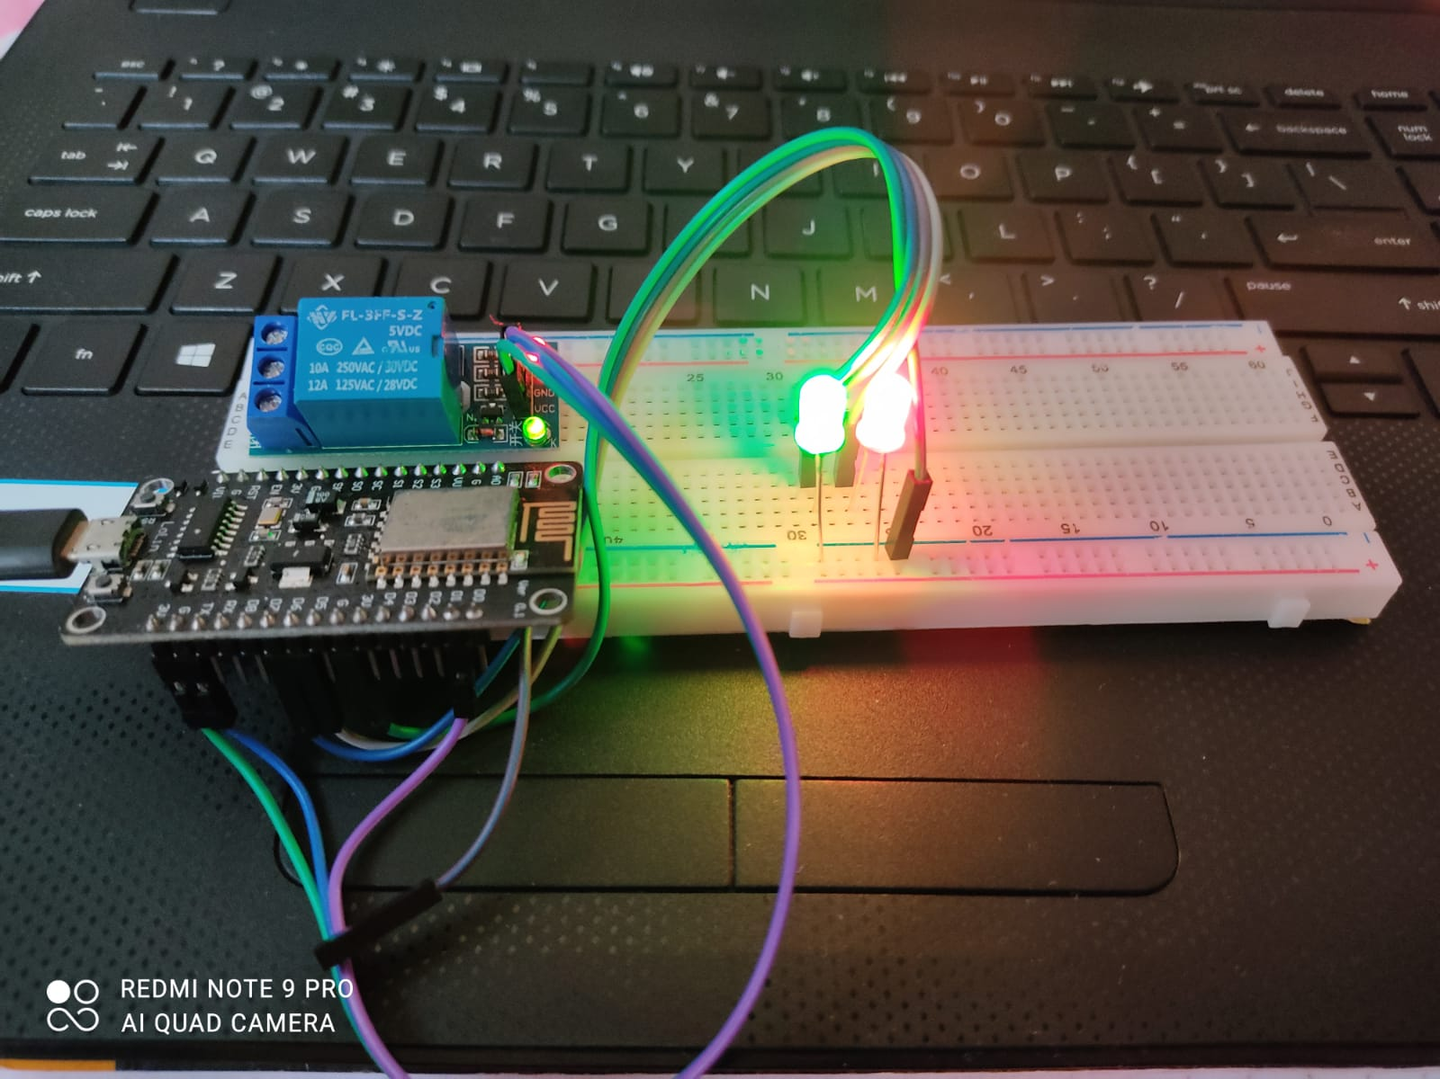
HARDWARE DEMONSTRATION

Slide 11
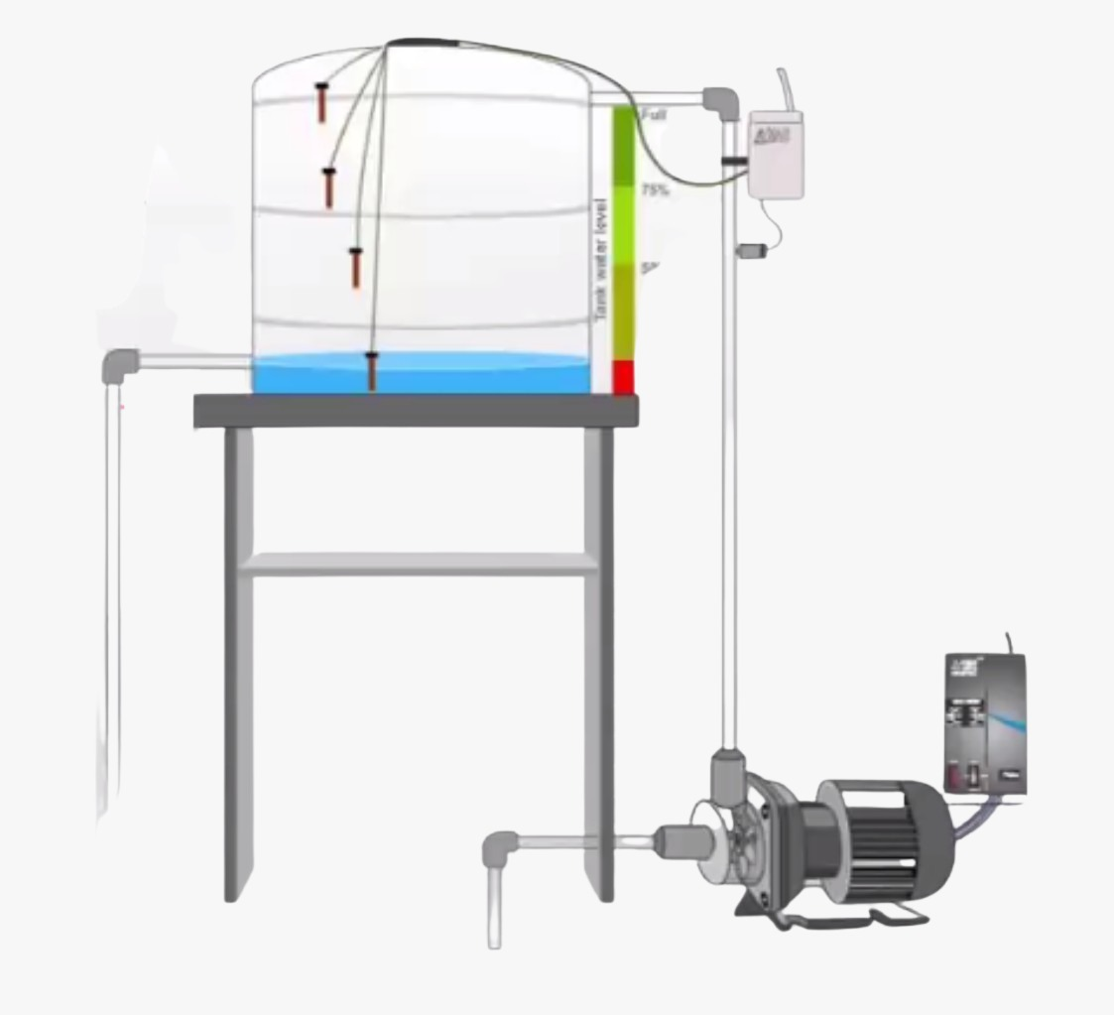
PROPOSED SYSTEM

Slide 12
Unique selling proposition
1.) This system is totally a wireless system.
2.)It is not only preventing the overflow of water but also detecting the quality of water.
3.) This system is easy to handle.
4.) We can do the Real time analysis of the water usage on monthly basis and quality as well.

Slide 13
Product roadmap and further work
1.) In the upcoming years, we want to implement this system in big cities to start the conservation of water and prevent the water wastage, so that the scarcity of water can be lower down.
2.) As the technology will be much more advanced in upcoming years, we will try to modify our system to make it more better and efficient and introduce Artificial Intelligence in it.
3.) The most important thing is that, our initiative is to make every city as a SMART CITY, so that the development of the nation can be achieved easily and also there is a way towards the Sustainable Development.

Slide 14
conclusion
With this Project, we can do the analysis of the water quality that is supplied in the cities and due to this we can maintain a report of the quality of water which can be helpful to determine that the supplied water is not harmful for the body.
Also this project helps to save the precious resource such as water and electricity from wasting down on daily basis.

Slide 15
THANK
YOU!

